Slide 1

Curfew e-Pass Management System
Developed in PHP & MySQL
BY
Niharika K(1DT19CS094)
Madhu Sudhan S(1DT19CS074)

Slide 2
SYNOPSIS
Computers have become a way of life for today’s high society. Many aspects of modern life that we have come to accept as common place would not be possible if there were no computers. Today computers are used extensively in many areas of business, industry, science, education etc.
The major advantage of computer is its speed that makes it able to give some useful information very quickly. This speed also opens new approaches to problem solving and data processing. Another feature is its accuracy. Though the computers do only what is instructed at every instant, these instructions are taken into account and accurate information’s are produced. Computer can hold data and instruction in an electronic representation in internal memory and this data can be retrieved at any time
The project entitled “Curfew E-Pass Management System” is a software package, which can be used in curfew for managing the pass of people’ computer efficiently.
This system is developed in PHP language with My SQL as backend. The system is a menu driven one. User-friendly menus will help the administrator to work on it without any operational difficulty

Slide 3
INTRODUCTION
Curfew Pass Management system is a web-based technology that will manage the records of pass which is issue by administrative and also help to provide online curfew e-pass to people who need to travel compulsory. Curfew Pass Management System is an automatic system which delivers data processing in very high speed in systematic manner.
In CPMS we use PHP and MySQL database. This is the project which keeps records of the pass which is issue by administrative. CPMS has three module i.e. admin, Subadmin, and User.
Admin
Sub-Admin
User

Slide 4
IDEA OF IMPLEMENTATION
ADMIN MODULE
Secure admin login system
Dashboard: In this section, admin can briefly view the total number of category and how many pass will be generated in one day, yesterdays and last seven’s days.
Sub-admin: In this section, Admin can create and manage the sub-admin(Add, update).
Category: In this section, admin can manage category (add/update).
Add Pass: In this section, admin add pass.
Manage Pass: In this section, admin can update pass and take print of that pass.
Reports: In this section, admin can generate pass reports between two dates and also generates report sub admin wise.
Search: In this section, admin can search a particular pass by pass number.
Admin Profile: In this section, Admin can update their profile details.
Change password: In this section, Admin can change their change password.
Admin can also recover their password..

Slide 5
SUB-ADMIN
Dashboard: In this section, Sub-admin can briefly view how many pass will be generated in one day, yesterdays and last seven’s days.
Add Pass: In this section, Sub-admin add pass.
Manage Pass: In this section, Sub-admin can update pass and take print of that pass.
Reports: In this section, Sub-admin can generate pass reports between two dates report.
Search: In this section, Sub-Admin can search a particular pass by pass number.
Sub-Admin Profile: In this section, Sub-Admin can update their profile details.
Change password: In this section, Sub-admin can change their change password.
User Module
User can visit home page and search pass details by entering pass number.

Slide 6
REQUIREMENT SPECIFICATION
Hardware Configuration:
Client Side
Server Side
RAM | 512 MB
Hard Disk | 10GB
Processor | 1.0 GHz
RAM | 1 GB
Hard Disk | 20GB
Processor | 2.0GHz

Slide 7
CONTINUE.....
Software Requirement:
Client Side
Server Side
Web Browser | Google Chrome or any compatible browser
Operating System | Windows or any equivalent OS
Web Server | APACHE
Server side Language | PHP5.6 or above version
Database Server | MySQL
Web Browser | Google Chrome or any compatible browser
Operating System | Windows or any equivalent OS

Slide 8
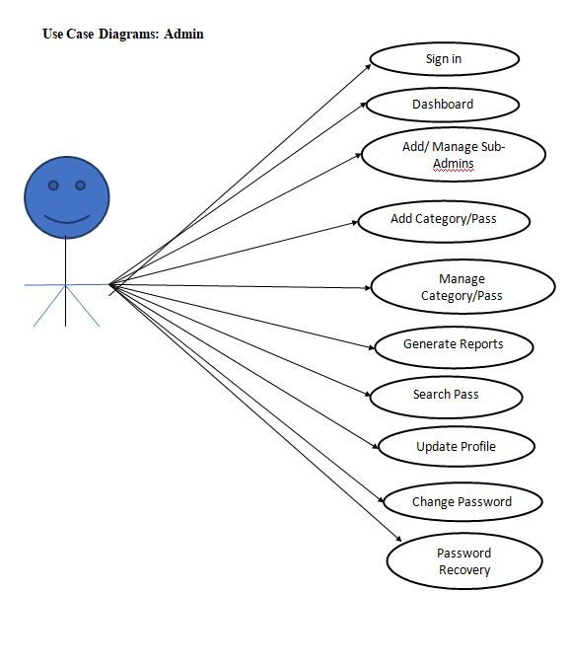
USE CASE DIAGRAM
Notes:
USECASE DIAGRAM: A Use case is a description of set of sequence of actions. Graphically it is rendered as an ellipse with solid line including only its name. Use case diagram is a behavioral diagram that shows a set of use cases and actors and their relationship. It is an association between the use cases and actors. An actor represents a real-world object. Primary Actor – Sender, Secondary Actor Receiver.

Slide 9
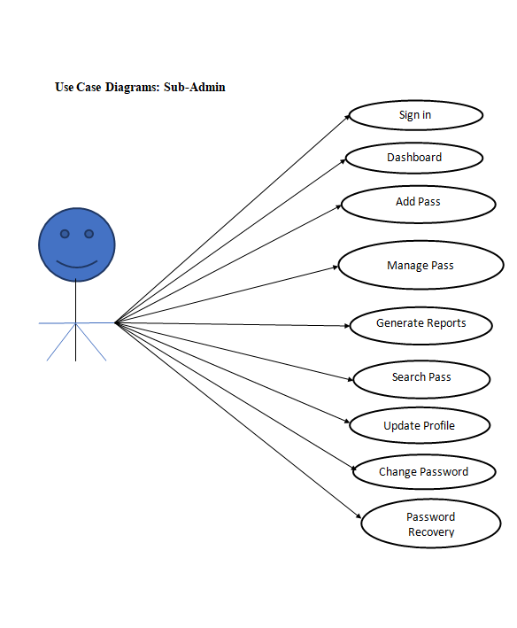
CONTINUE.......

Slide 10
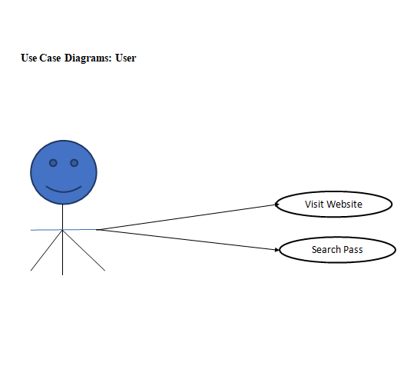
CONTINUE.......

Slide 11
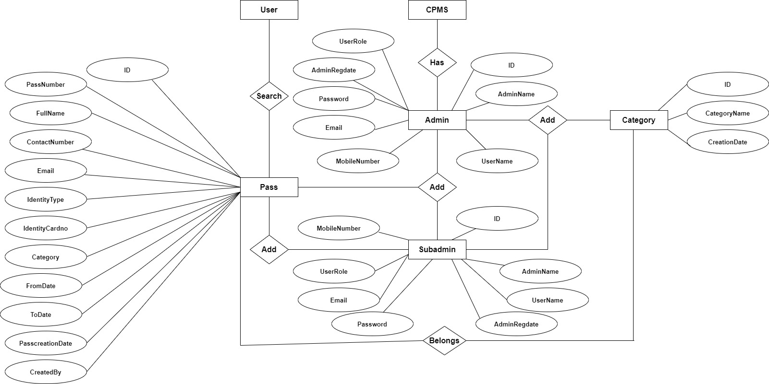
ER Diagram

Slide 12
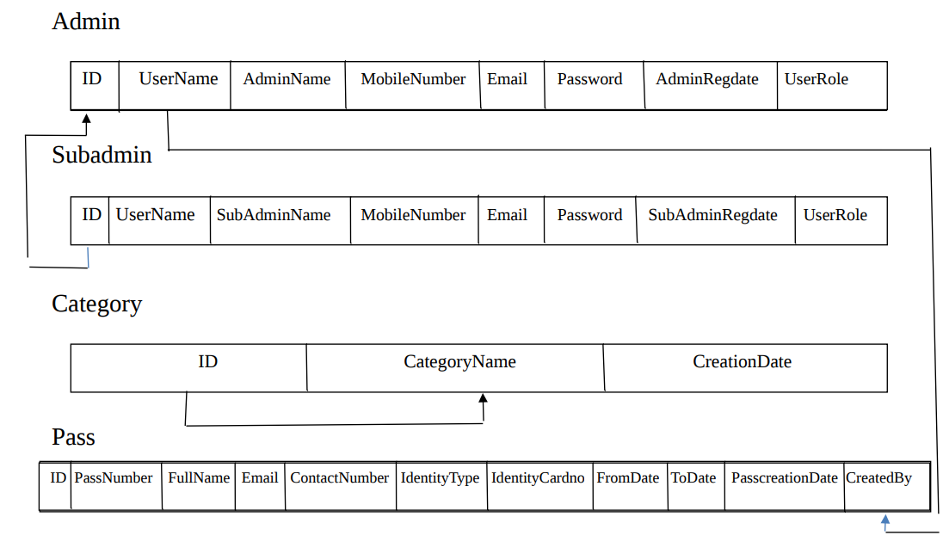
RELATIONAL SCHEMA

Slide 13
Implementation and
System Testing
After all phase have been perfectly done, the system will be implemented to the server and the system can be used.
System Testing
The goal of the system testing process was to determine all faults in our project .The program was subjected to a set of test inputs and many explanations were made and based on these explanations it will be decided whether the program behaves as expected or not. Our Project went through two levels of testing
Unit testing
Integration testing

Slide 14
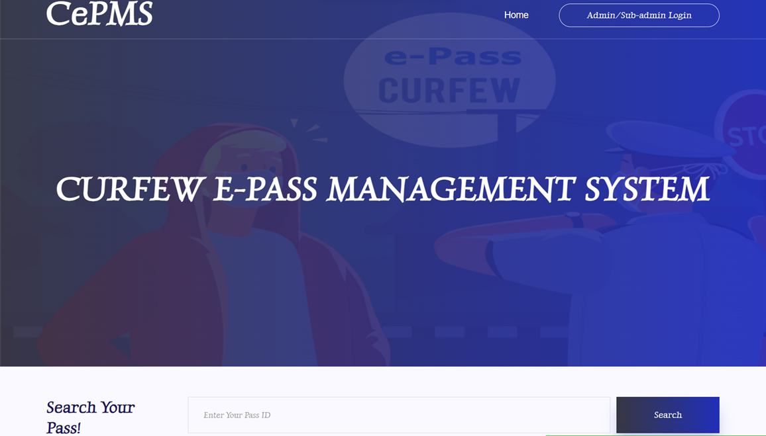
PROJECT SCREENS
Home Page

Slide 15
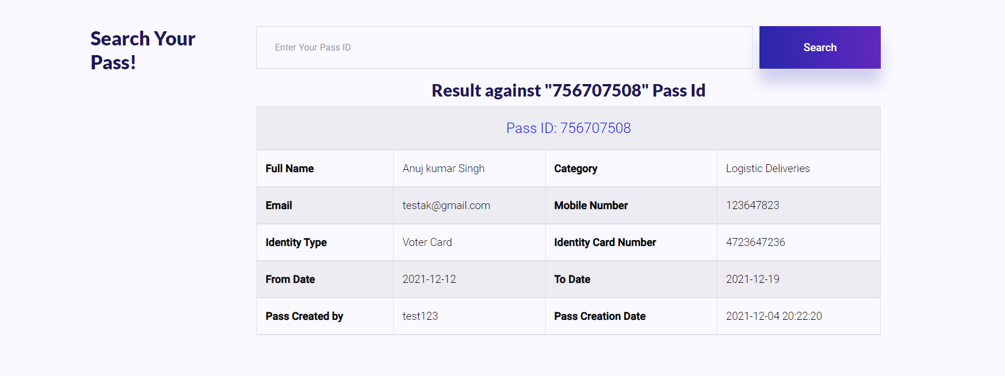
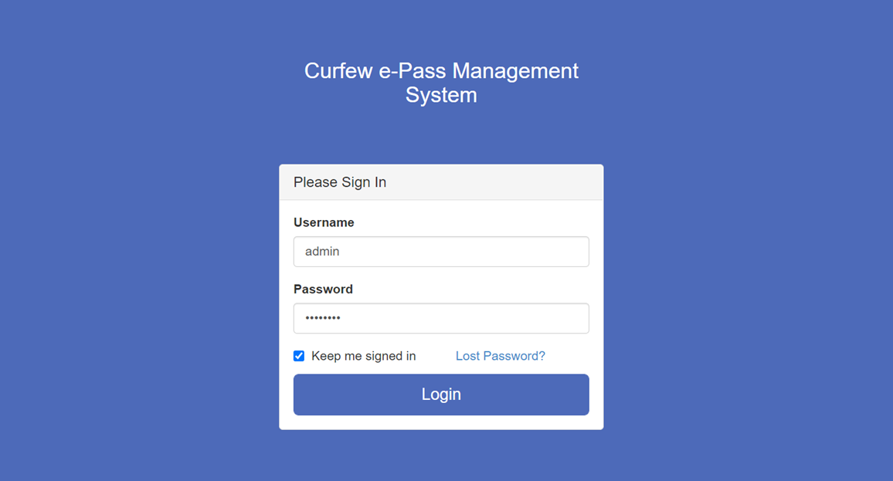
Admin login

Slide 16
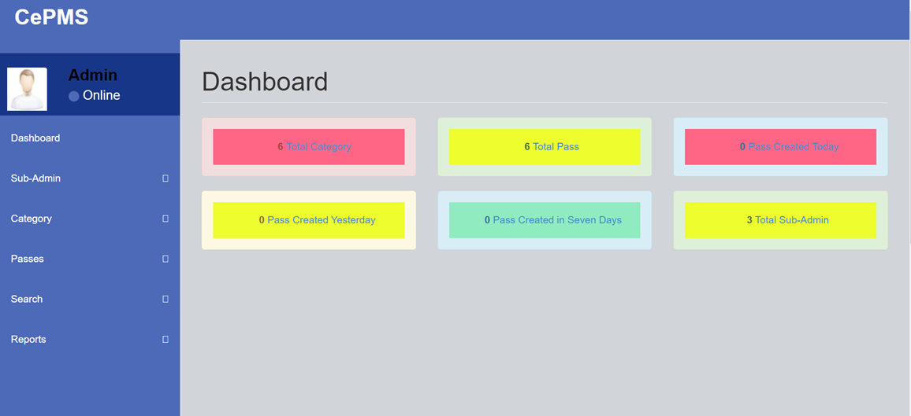
Dashboard

Slide 17
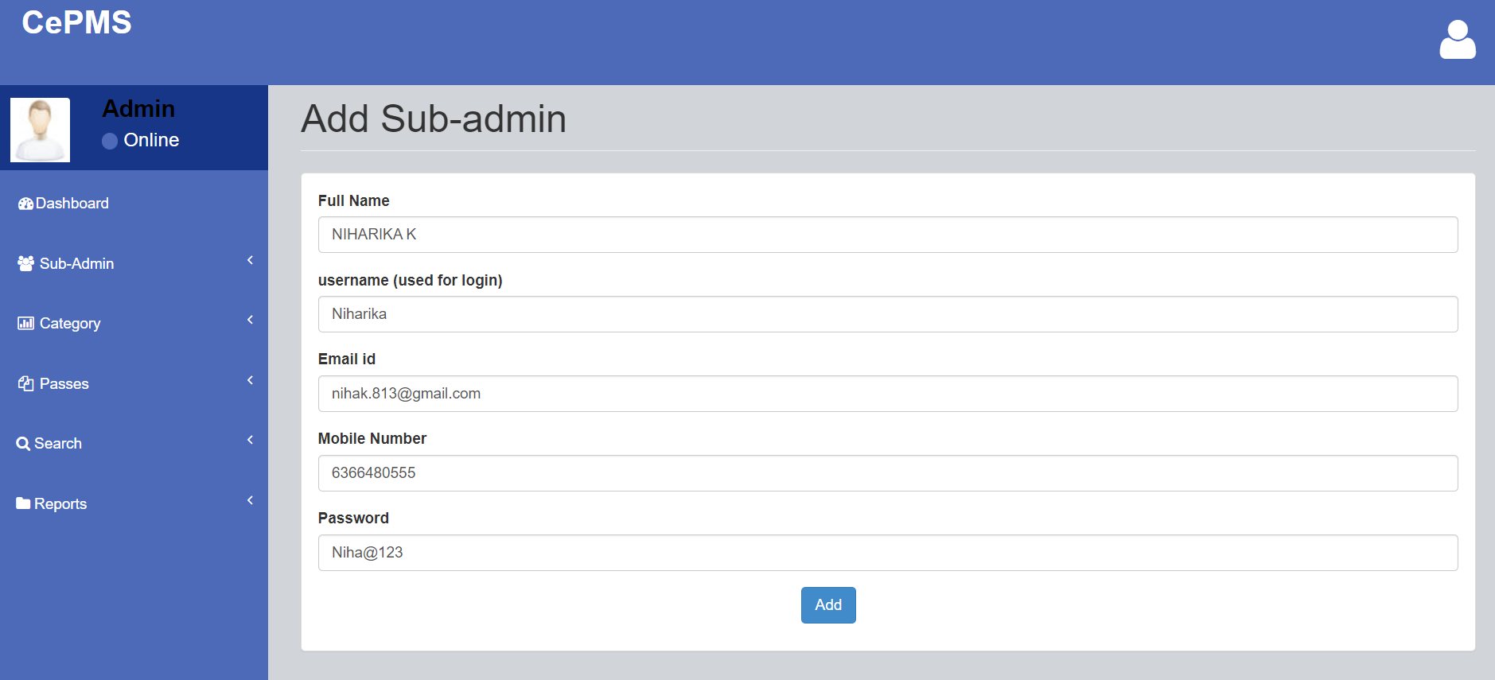
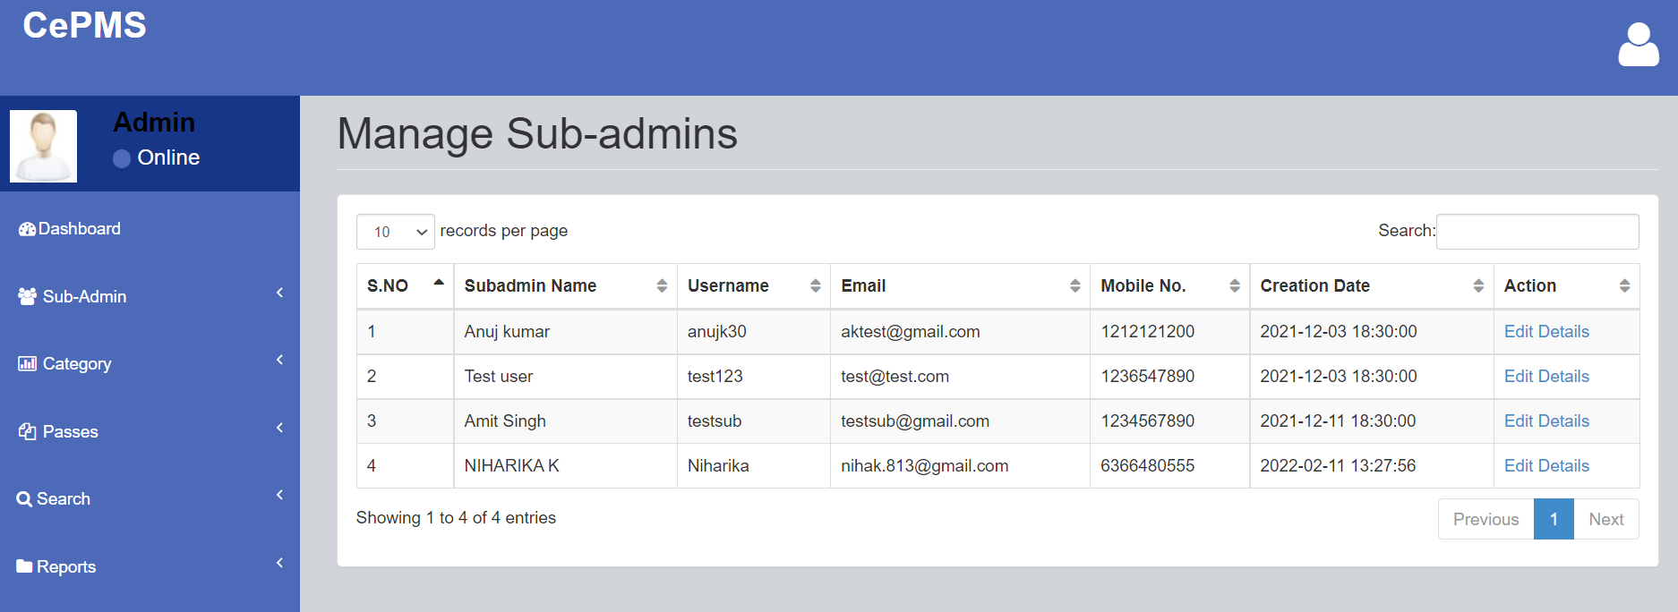
Admin Profile
Manage sub-admin

Slide 18
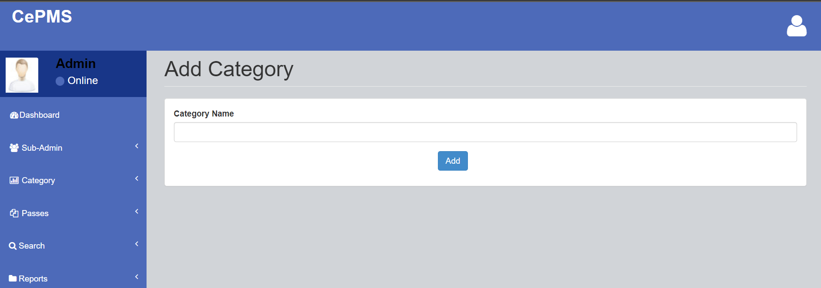
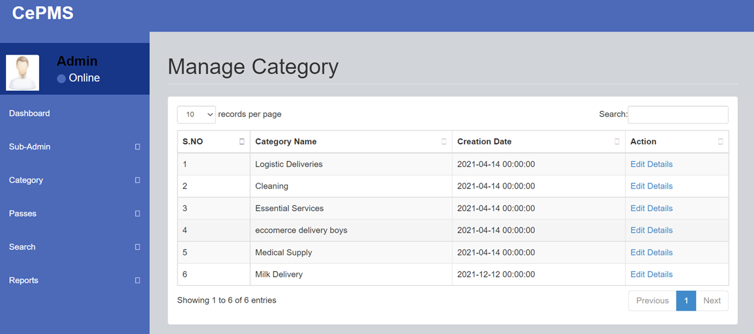
Add Category
Manage Category

Slide 19
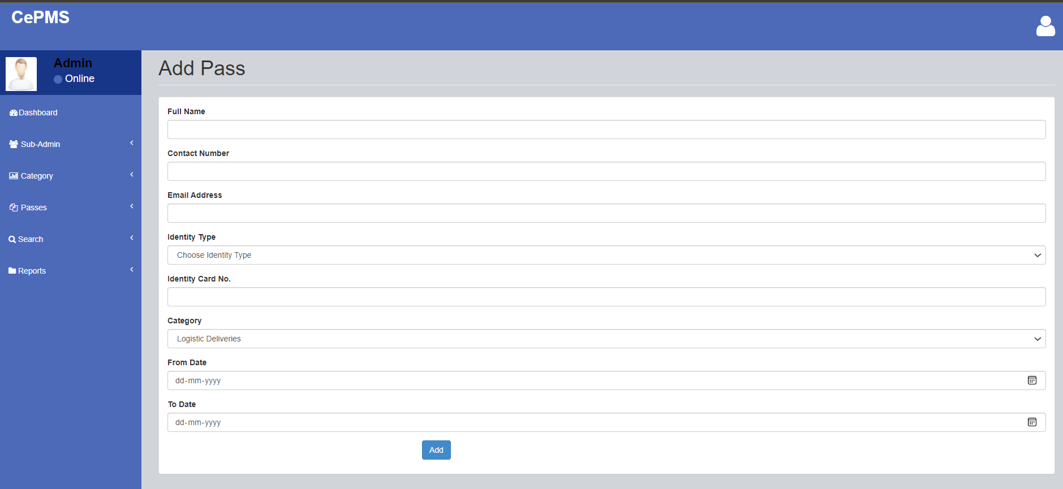
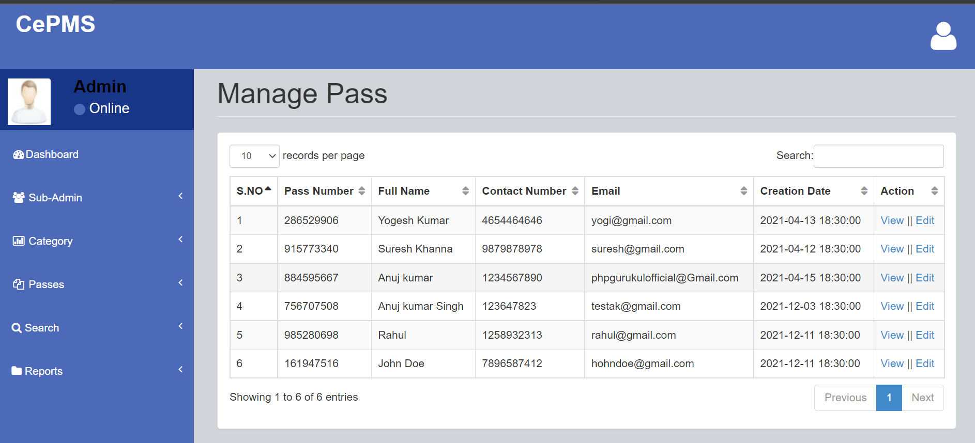
Add Pass
Manage Pass

Slide 20
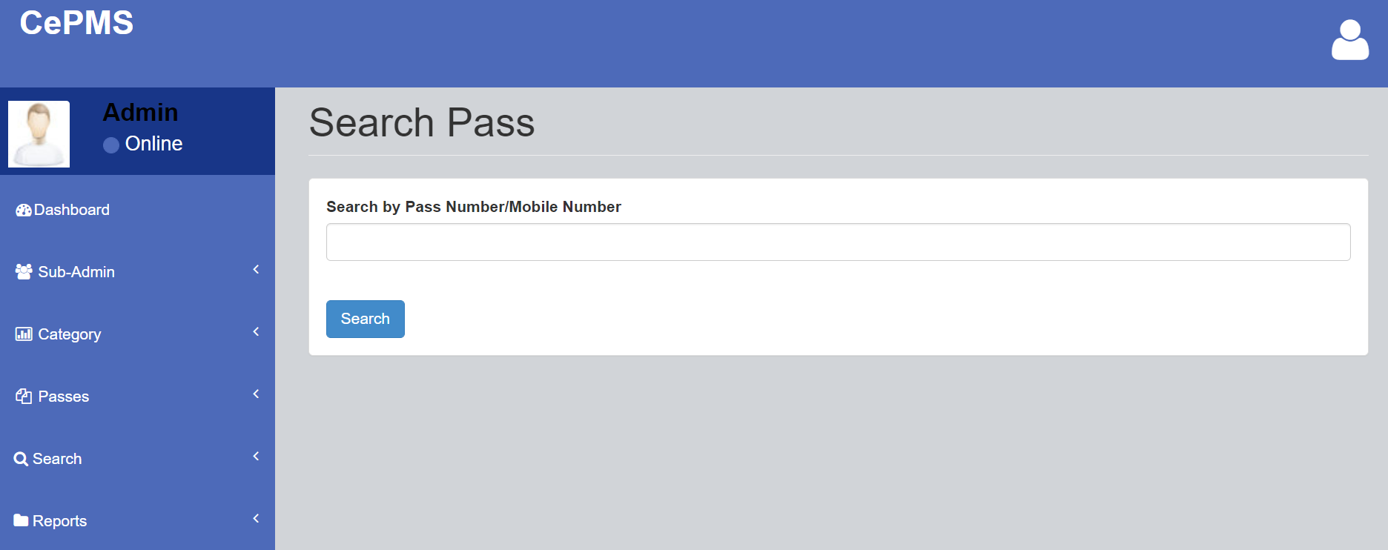
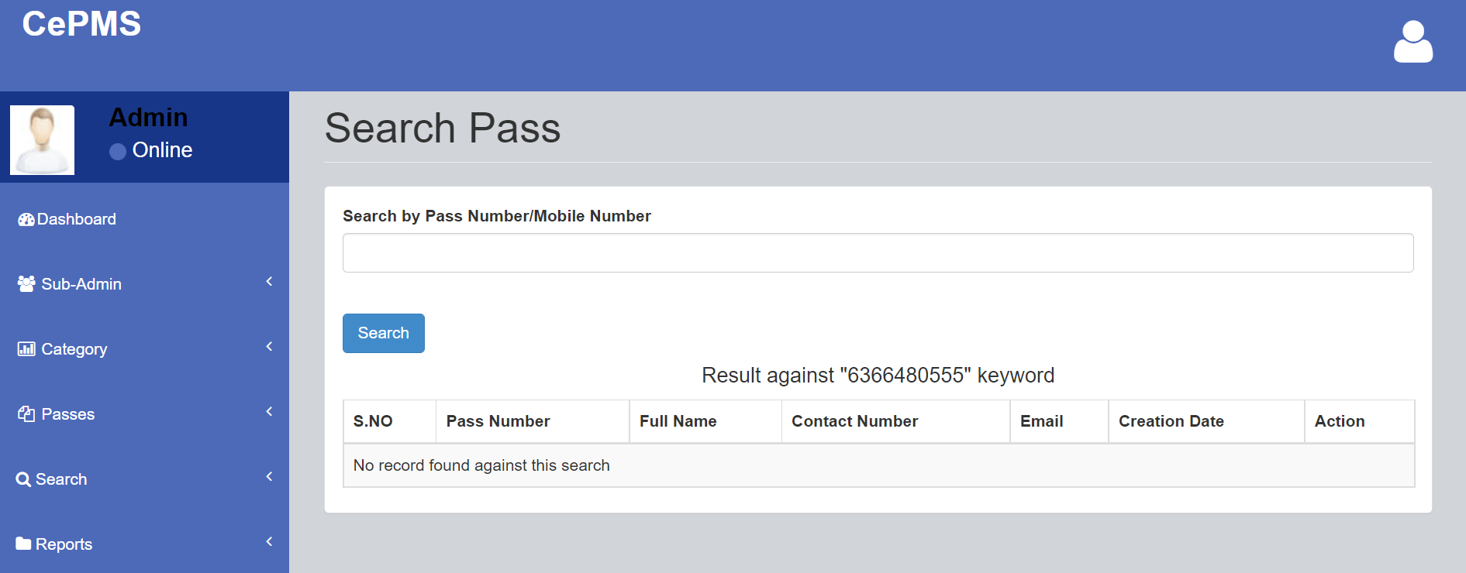
Search Pass
Search Pass

Slide 21
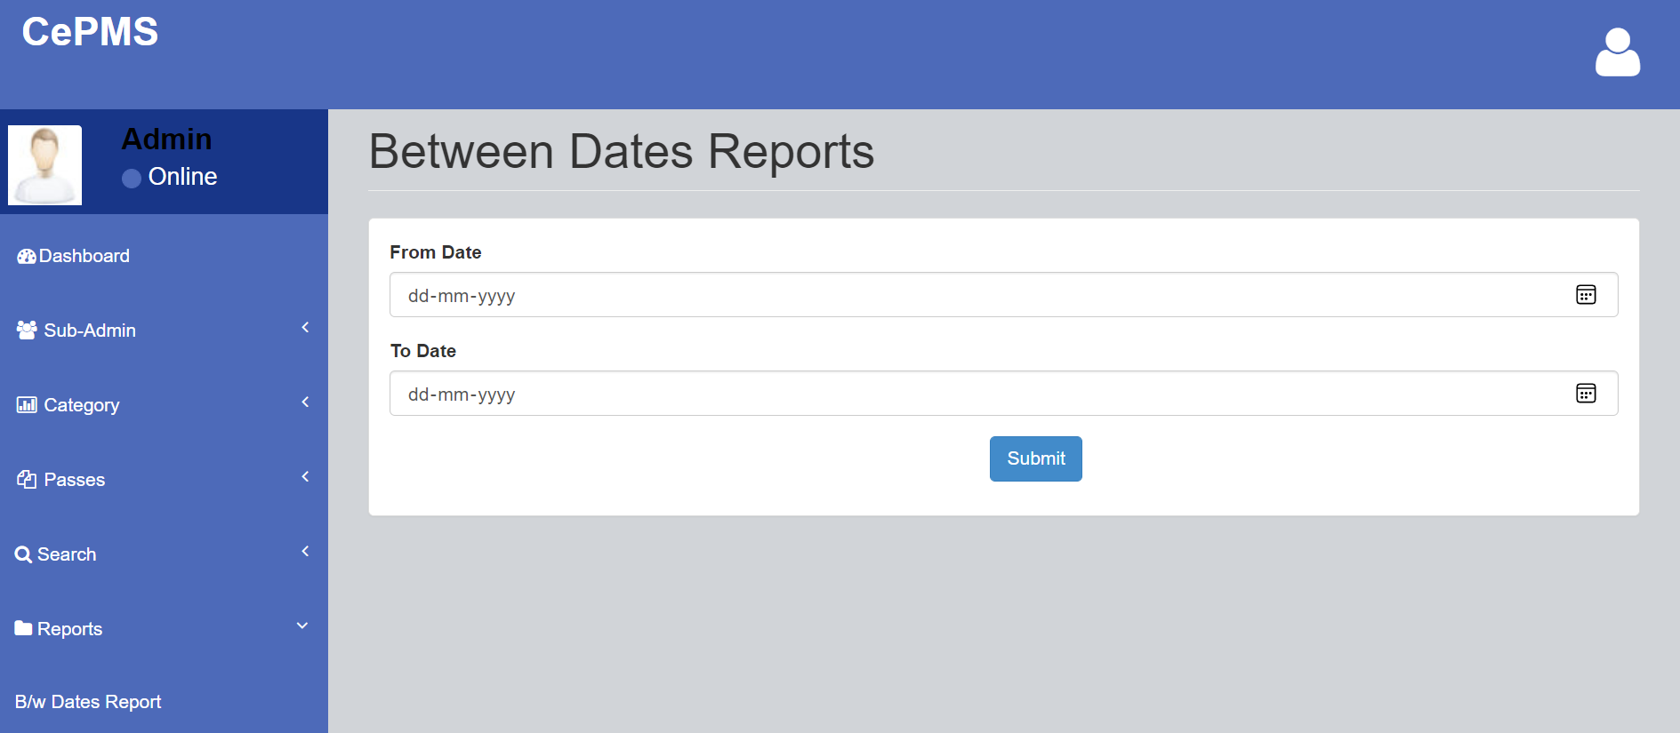
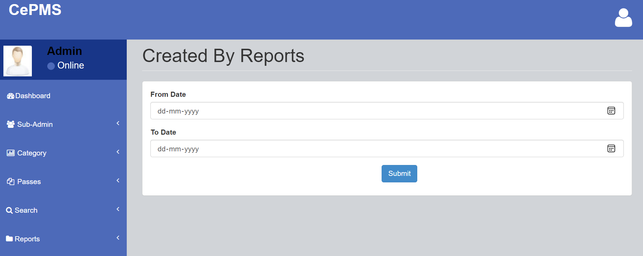
Between Dates Reports
Created By Reports

Slide 22
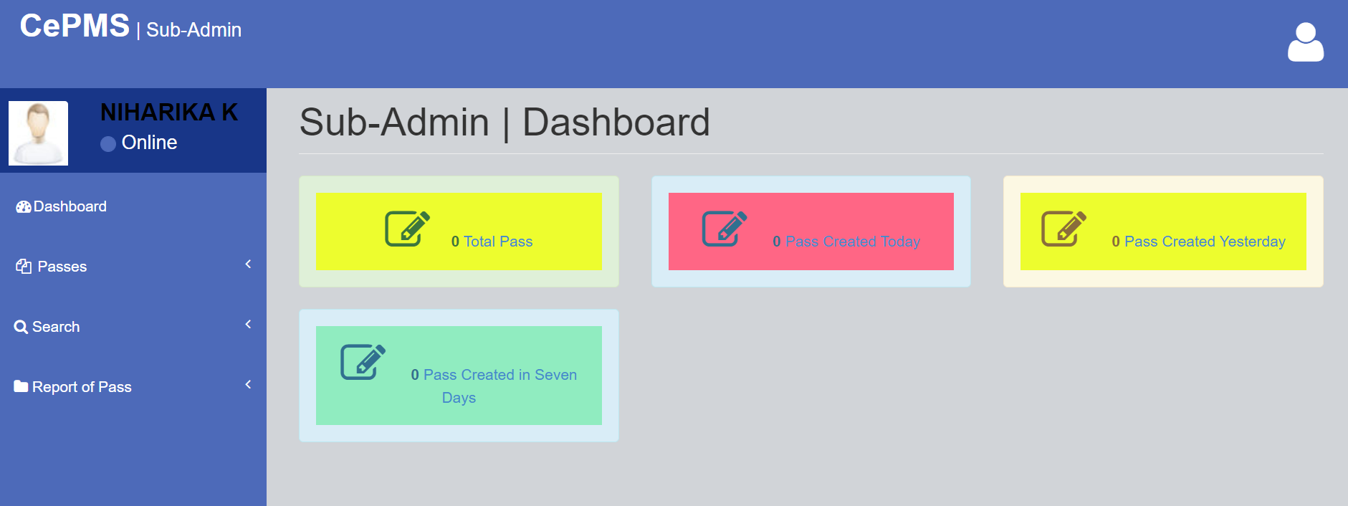
Sub-Admin|Dashboard

Slide 23
CONCLUSION
The Curfew Pass Management System is a great improvement over the manual system which uses lots of manual work. The computerization of the system speeds up the process. This system was thoroughly checked and tested with dummy data and found to be very reliable.
FEATURES INCULDE
It is fast, efficient and reliable.
Avoids data redundancy and inconsistency
Web-based
Any number of Faculty can use it
Provides more security and integrity to data

Slide 24
REFERENCES
For PHP
https://www.w3schools.com/php/default.asp
https://www.sitepoint.com/php/
https://www.php.net/
For MySQL
https://www.mysql.com/
http://www.mysqltutorial.org
For XAMPP
https://www.apachefriends.org/download.html

Slide 25
Thank You!

